Slide 1

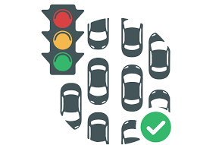
MINI PROJECT ON CONTROL OF TRAFFIC FLOWS USING GAUSSIAN ELIMINATION
Submitted by, Ayushi Agarwal (PES2201800053)
Aparna.R (PES2201800345)

Slide 2
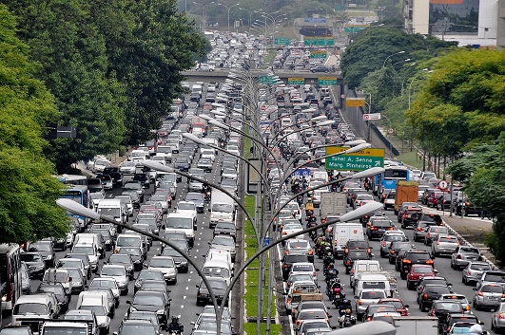
TRAFFIC CONGESTION
Traffic congestion slows down the vehicles movement on the road and it brings a series of issues including extra travel times for the drivers and passengers, increased fuel consumptions, greenhouse gas emissions, higher vehicular crash rates and so on.

Slide 3
INTRODUCTION
The research paper presented here talks about the problems caused due to traffic congestion and the ways to resolve it using linear algebra.
It also takes into account the various mathematical approaches like Gaussian elimination and optimal number of sensors.
We used a system of linear equations to determine the number of vehicles that should be allowed to route a four one-way roads, in order to keep traffic flowing.
Non-mathematical approaches like Priority queue, Autonomous vehicle and V2I technology.

Slide 4
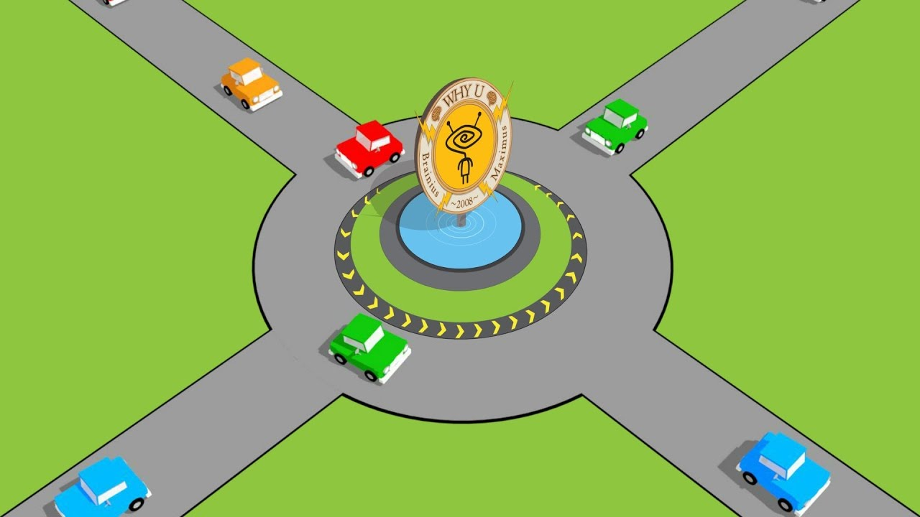
FOUR ONE WAY JUNCTION
Assumptions for the problem:
Assume the number of vehicles entering an intersection equals the number of vehicles exiting.
Assume constant traffic flow in between intersection.

Slide 5
HOW DOES LINEAR ALGEBRA SOLVE OUR PROBLEM?
Traffic systems rely heavily on matrices:
Measure traffic flow in and out of intersections.
Direct the cycle of the traffic lights.
Matrices provide organization for large amounts of data.
Significantly improves travel efficiency by minimizing wait lines.
Matrices in result display set of all possible solutions.

Slide 6
WHY SYSTEMS OF LINEAR EQUATIONS?
In order to represent our collected flow rate data.
Each equation represents a different part of the intersection.
Gaussian elimination yields the solutions for unknown rates.
Use to optimize traffic control.

Slide 7
WHY CHOOSE GAUSSIAN ELIMINATION?
When ordinary elimination or substitution with more than 3 variables becomes cumbersome.
The series of operations that are performed on the matrix of coefficients for reduction of matrix is called Gaussian elimination method. Gaussian Elimination method is a solution for matrix of the form Ax=b. Hence, we can obtain the values of the unknown by bringing it to reduced echelon form followed by back substitution.
For many scientific computations it is necessary to solve linear equation so good option is to solve it by algorithm of Gaussian elimination method.

Slide 8
PERFORMANCE COMPARISON OF GAUSS ELIMINATION AND GAUSS-JORDAN ELIMINATION
SUMMATIVE EXECUTION TIME
Numbers of Variables | Execution Time for Gauss Elimination method (Macro Second) | Execution Time for Gauss-Jordan Elimination method (Macro Second)
2 | 254.4 | 318.4
3 | 299.6 | 374.8
4 | 347.6 | 353.4
5 | 389.4 | 398
6 | 373.2 | 378.6

Slide 9
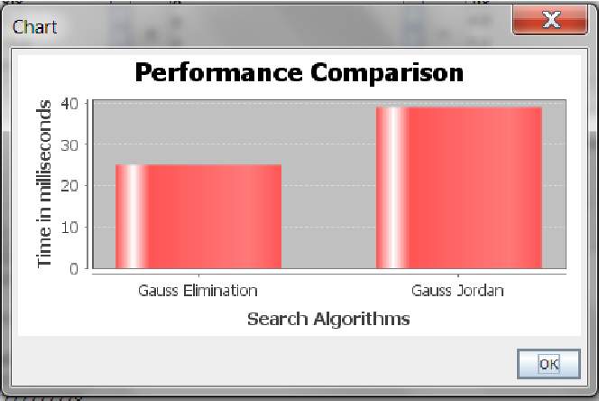
BAR GRAPH

Slide 10
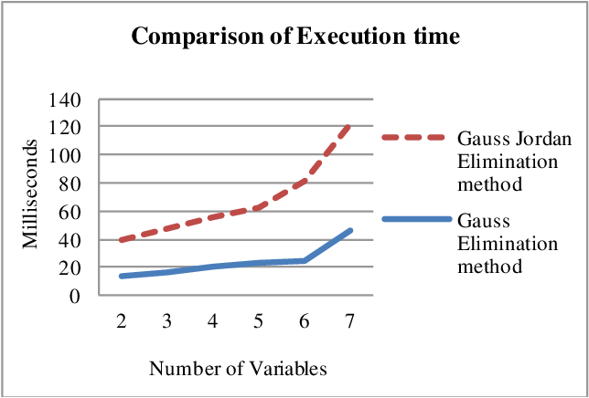
Line Graph Between time taken by different Algorithm in MAT LAB
We observe the slope of the Graph.
Conclusion can be drawn that time taken by Gauss Elimination Method is faster than the Gauss Jordan Elimination method.
Notes:
Gaussian elimination vs. Gauss Jordan elimination comparison: http://www.ijetsr.com/images/short_pdf/1508828853_753-763-bbec447_ijetsr.pdf

Slide 11
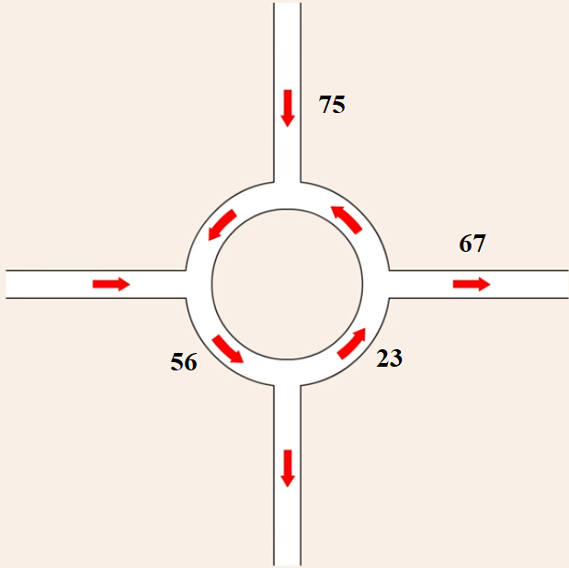
MATHEMATICAL APPROACH
1. Gaussian elimination
Before using Gaussian Elimination:
We initially got these values for the number of vehicles crossing per minute.
Since there are more than 3 unknowns, we use gauss elimination.

Slide 12
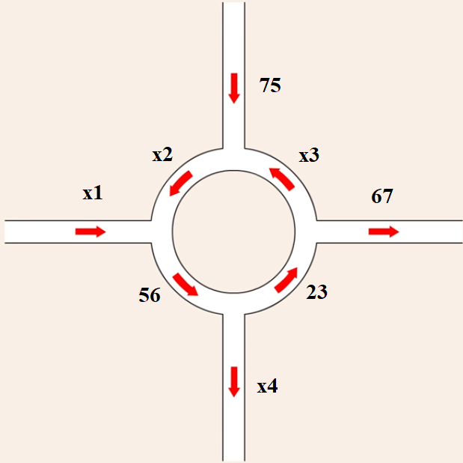
We label the unknowns as x1,x2,x3 and x4 in order to calculate traffic through each intersection precisely.

Slide 13
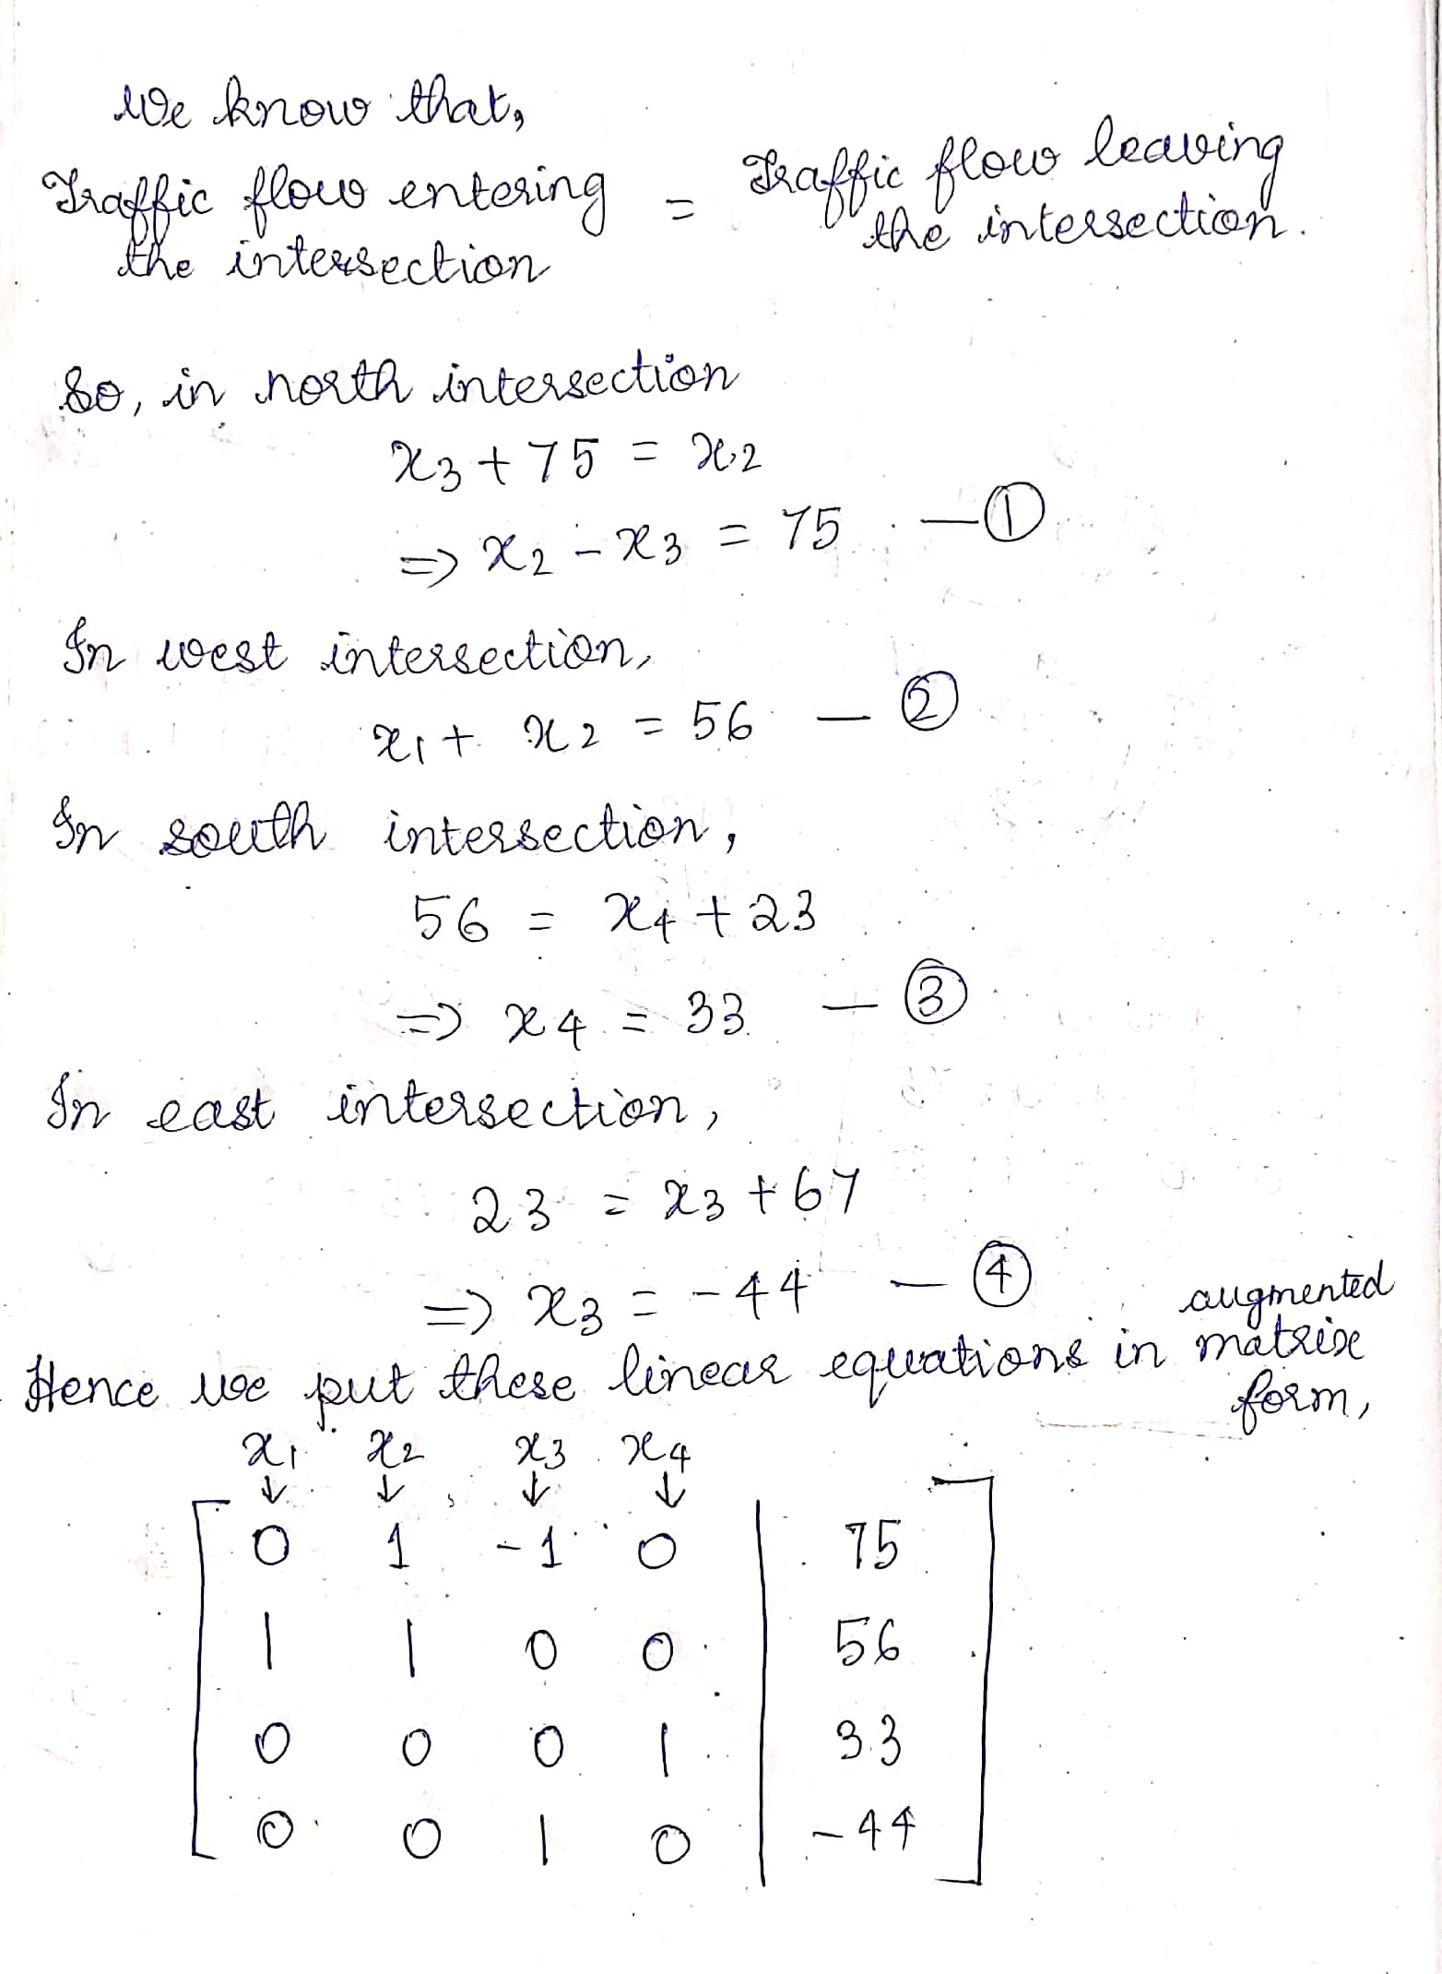

Slide 14
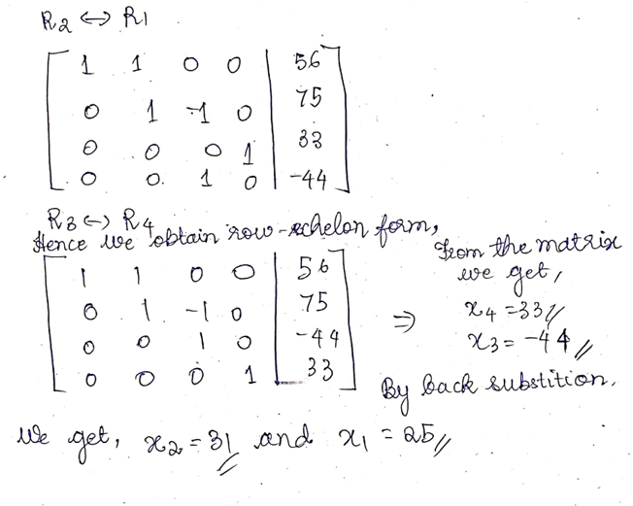

Slide 15
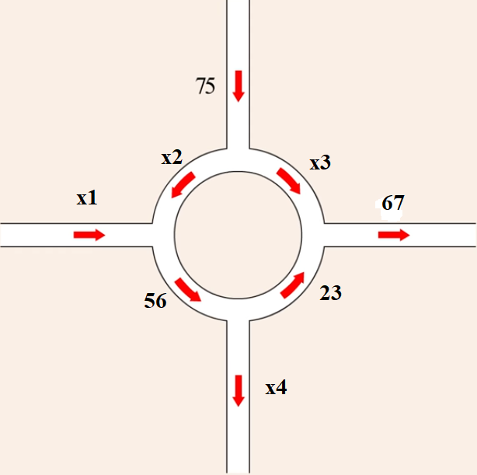
Since x3 is negative, we reverse the direction of traffic flow.

Slide 16
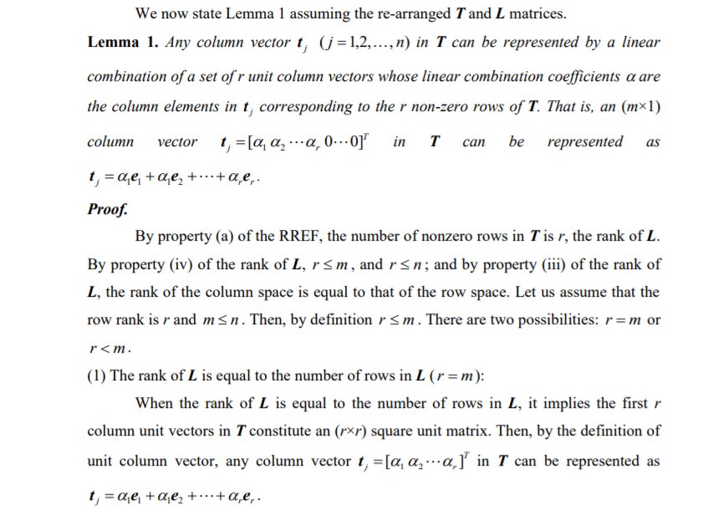
2. Number of Sensors

Slide 17
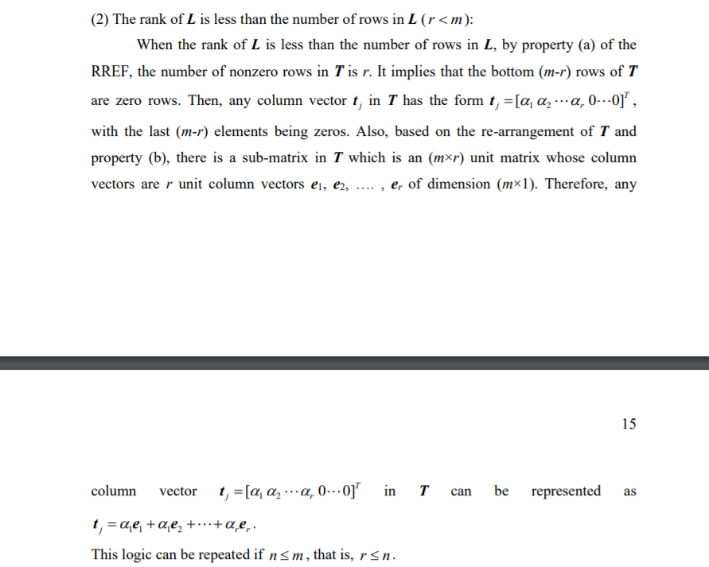

Slide 18
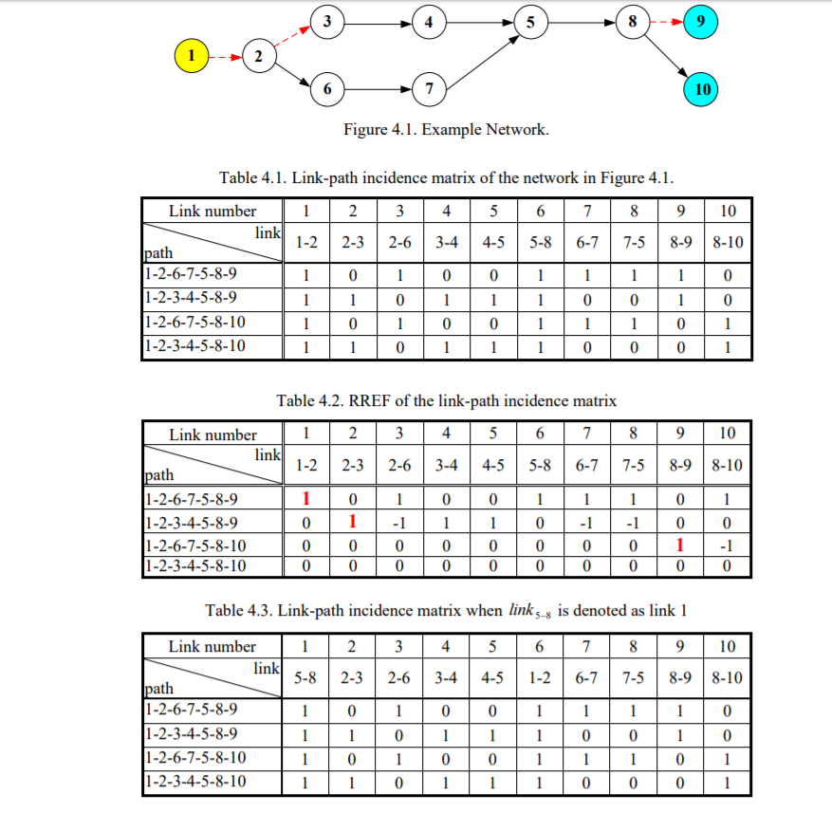

Slide 19
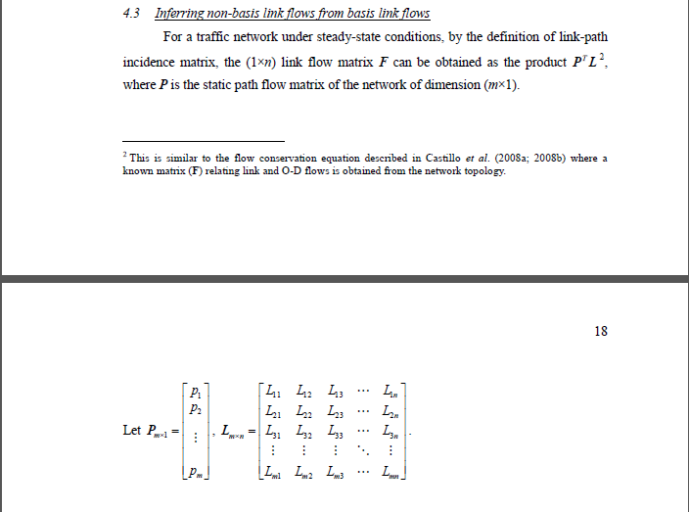

Slide 20
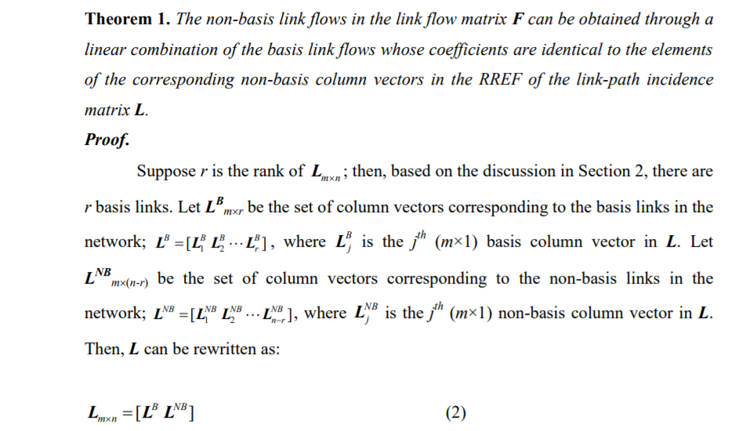

Slide 21
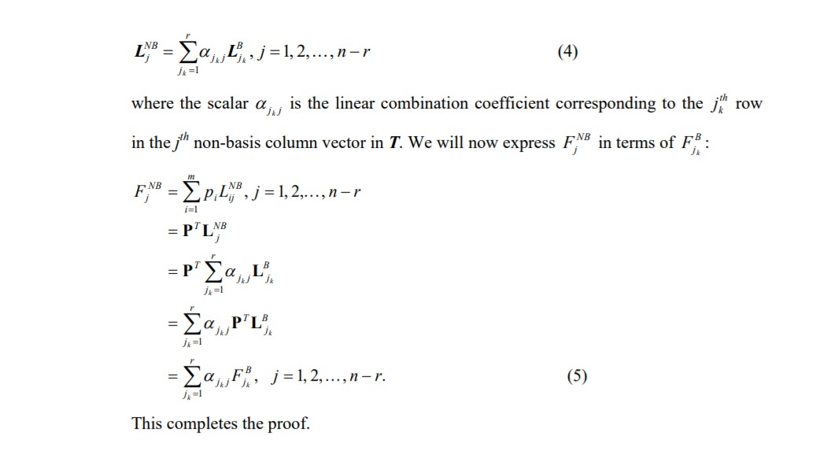

Slide 22
EFFECT OF NETWORK TOPOLOGY
1.1 Parallel highway network:
The parallel highway network shown below is analyzed using the basis link method. It consists of 4 O-D pairs, 14 links, and 9 nodes. Nodes 1 and 2 are trip origin nodes, and nodes 8 and 9 are the destination nodes.
Below table illustrates the link-path incidence matrix for the network. The Gaussian elimination algorithm is used to obtain its RREF. The basis links correspond to the 9 shaded columns in the table. They include links 1, 2, 3, 4, 5, 7, 9, 11, and 13. They represent the links on which to install vehicle sensors.
Hence, about 64% of the links need to be equipped with sensors to estimate the flows on all links in the parallel highway network under steady-state conditions.

Slide 23
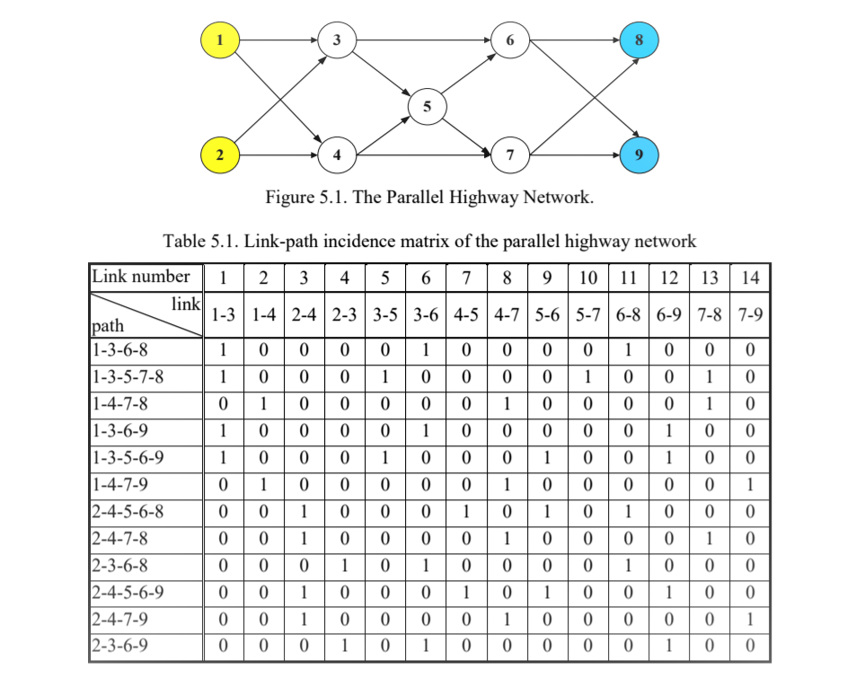
GRAPICAL VIEW OF PARALLEL HIGHWAY NETWORK AND LINK PATH INCIDENCE MATRIX

Slide 24
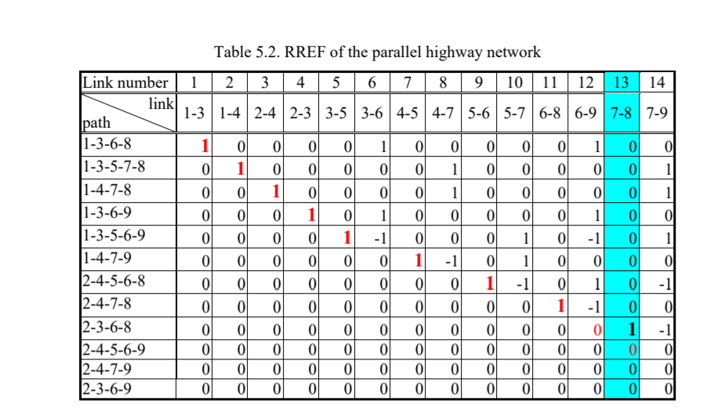
ROW REDUCED ECHLEON FORM

Slide 25
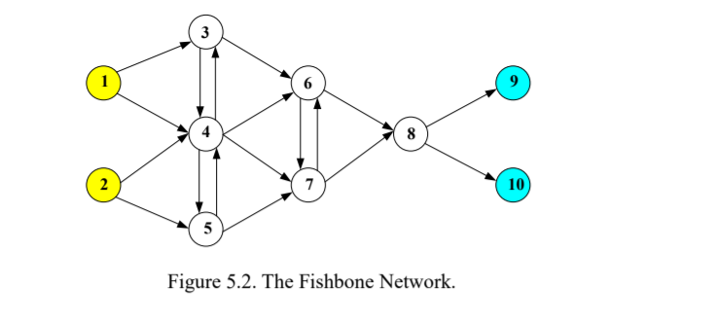
1.2 Fishbone Network:
The second network analyzed is the fishbone-shape network shown in below figure. It contains 4 O-D pairs, 18 links, and 10 nodes.
Nodes 1 and 2 are the origin nodes, and nodes 9 and 10 are the destination nodes.
The RREF of the link-path incidence matrix of the fishbone network is obtained by the Gaussian elimination algorithm and identifies 12 basis links: 1, 2, 3, 4, 5, 6, 8, 9, 10, 13, 14, and 17.
Hence, in this 18-link network, only 12 sensors are needed to obtain the flow information on all links. Thereby, only 67% of the network links need to be equipped with sensors.

Slide 26

NON - MATHEMATICAL APPROACH
I. Priority Queue
Priority Queuing is a Congestion Management technique. It schedules traffic such that the higher-priority queues i.e. Queue with maximum number of vehicles "always" gets cleared first so that people don’t have to wait unnecessarily in the queue.

Slide 27
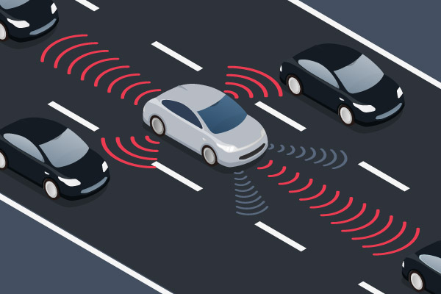
II. Autonomous vehicle technology
With fewer accidents and driver-caused traffic, autonomous vehicles are likely to reduce congestion.
If all roads on the vehicle had autonomous technology, vehicles would be able to speed up and slow down, and merge onto and off freeways without human direction, creating a much smoother driving pattern.
It would eliminate human error that causes issues like “phantom traffic,” which is caused by the ripple effect of a driver braking in the middle of a freeway.

Slide 28
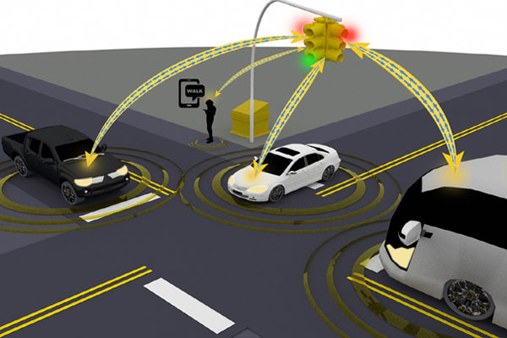
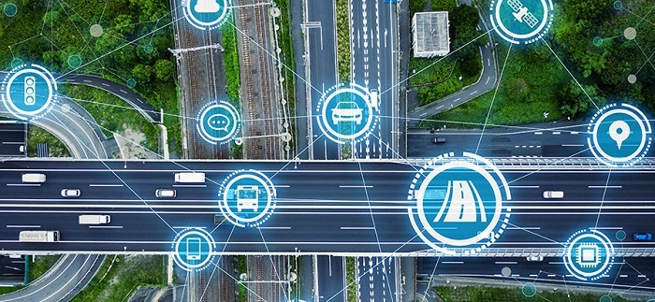
3. Vehicle-to-infrastructure technology (V2I)
In this technology, the vehicle is able to send and receive information. Using V2I technology, we can implement a pilot project that would send safety-related weather and accident alerts to drivers planning to drive.
The vehicle can send data out while simultaneously the infrastructure can send important data back.
We expect a significant effect on safety and even the economy since the government will likely spend less energy on accident clean-up .

Slide 29
CONCLUSIONS
Addresses the network sensor location problem (NSLP) directly so as to obtain the unobserved link flows given the minimum subset of observed link flows provided by passive counting sensors.
Analyzes the corresponding theoretical aspects related to the proposed basis link method in the determination of the minimum subset of network links to infer unobserved link flows.
Given the network structure represented by its link-path incidence matrix, a theoretical minimum subset of network links provided by the reduced row echelon form (RREF) algorithm does exist, and a direct mapping between the basis link flows and the non-basis link flows is also theoretically proved.
Priority Queuing is a Congestion Management technique that schedules traffic such that the higher-priority queues gets cleared first so that people don’t have to wait unnecessarily in the queue.
Autonomous vehicle technology would eliminate human error and are likely to reduce congestion.
Using V2I technology, we expect a significant effect on safety and even the economy.

Slide 30
FUTURE RESEARCH
DIRECTIONS

Slide 31
REFERENCES
REFERENCE BOOKS:
Title of the book : Linear Algebra and its Applications
Author: Gilbert Strang
Edition: 4th
Chapter no. : 1 - Matrices and Gaussian elimination
Page no. : 13
Publisher: Thomson, Brooks/Cole, 2006
Year of publication: January 1968
2. Title of the book : Linear Algebra and its Applications
Author: David C. Lay, Steven R. Lay, Judi J. McDonald
Edition: 5th
Chapter no. : 1 - Linear equations in Linear Algebra
Page no. : 12, 35
Publisher: Pearson
Year of publication: July 2018

Slide 32
REFERENCE JOURNALS:
Gaussian elimination vs. Gauss Jordan elimination comparison: http://www.ijetsr.com/images/short_pdf/1508828853_753-763-bbec447_ijetsr.pdf
Application of System of Linear Equations to Traffic Flow for a Network of Four One-Way: http://www.m-hikari.com/ijcms/ijcms-2014/13-16-2014/aduIJCMS13-16-2014.pdf
Network Origin-Destination Demand Estimation: https://www.purdue.edu/discoverypark/nextrans/assets/pdfs/completedprojects/Final%20Report%20018.pdf
Approach to Priority-based Controlling Traffic Lights: https://www.researchgate.net/publication/298716558_Approach_to_Priority-Based_Controlling_Traffic_Lights
Observability of traffic networks: https://www.tandfonline.com/doi/full/10.1080/21680566.2013.780987
Real time traffic models: https://reader.elsevier.com/reader/sd/pii/S1878029614001698?token=EBDF02C46C866F8539B310E1D4DE8BED9DFB003851CAF7B0522BB8F01EC95BAD4F56CFF0B8A40613078092BDCD86B0A6

Slide 33
OTHER ONLINE REFERENCES:
1. Gaussian elimination using traffic flows:
https://www.youtube.com/watch?v=Wa6kaCwyYRk&t=674s
2. Traffic flows:
https://en.m.wikipedia.org/wiki/Traffic-flow
3. Reduce traffic flows:
https://www.geotab.com/blog/reduce-traffic-congestion/

Slide 34
Thank You ☺

